Slide 1
Chapter 3
Basic concept of C

Slide 2
Learning Objectives
First programming course
No previous knowledge is assumed !
By the end of the course, students will:
Understand fundamental concepts of computer programming/imperative structured programming languages
Design algorithms to solve (simple) problems
Use the C programming language

Slide 3
History of C
An ancestor of C is BCPL – Basic Combined Programming Language. Ken Thompson, a Bell Laboratory scientist, developed a version of BCPL, which he called ‘B’.
Dennis Ritchie, another computer scientist, developed a version called ‘C’ in early 1970s that is modified and improved BCPL.
Ritchie originally wrote the language for programming under UNIX operating system. Later Bell Laboratories rewrote UNIX entirely in C.
Many providers of C compilers for many different platforms => need for standardization of the C language
1990: ANSI C (American National Standards Institute)

Slide 4
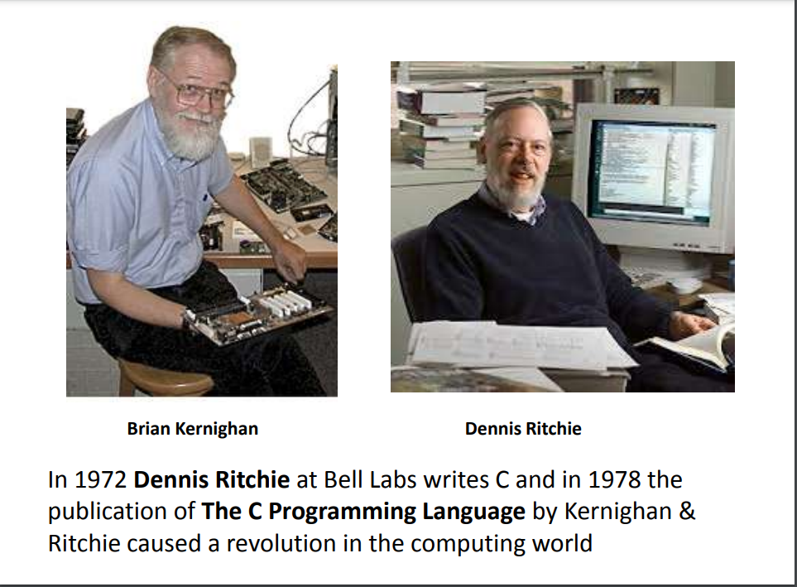

Slide 5
Why C?
Mainly because it produces code that runs nearly as fast as code written in assembly language. Some examples of the use of C might be:
Operating Systems
Language Compilers
Assemblers
Text Editors
Print Spoolers
Network Drivers
Modern Programs
Data Bases
Language Interpreters
Utilities

Slide 6
Features of C
Procedural Language: C program may contain more than one function to perform a particular task
Fast and Efficient: C programming language as the been middle-level language is faster and provides programmers access to direct manipulation with the computer hardware which higher-level languages lack.
Statically Type (strongly type language): Meaning the type of variable is checked at the time of compilation but not at run time.
General Purpose Language: From system programming to photo editing software, C programming language is used in various applications.
Rich set of built in Operators: It is a diversified language with a rich set of built-in operators which are used in writing complex or simplified C programs.
Libraries with rich Functions: Robust libraries and functions in C help even a beginner coder to code with ease.
Middle Level Language: As it is a middle-level language so it has the combined form of both capabilities of assembly language and features of the high level language.
Portability: C language is portable as programs which are written in C language can run and compile on any system with either none or small changes.
Easy to Extend: A C program is basically a collection of functions that are supported by the C library this makes us easier to add our own functions to C library.

Slide 7
Disadvantages of C
C is a procedure oriented language and does not supports OOP methodology.
No strict type checking that means we can pass an integer value to a float data type.
Lack of exception handling
Developing large scalable applications is not appropriate in C.

Slide 8
Structure of a C Program
A C program basically consists of the following parts −
Preprocessor Commands
Functions
Variables
Statements & Expressions
Comments

Slide 9
Structure of a C Program contd…
#include <stdio.h>
int main() {
/* my first program in C */ printf("Hello, World! \n");
return 0;
}

Slide 10
Structure of a C program contd…
Let us take a look at the various parts of the above program −
The first line of the program #include <stdio.h> is a preprocessor command, which tells a C compiler to include stdio.h file before going to actual compilation.
The next line int main() is the main function where the program execution begins.
The next line /*...*/ will be ignored by the compiler and it has been put to add additional comments in the program. So such lines are called comments in the program.
The next line printf(...) is another function available in C which causes the message "Hello, World!" to be displayed on the screen.
The next line return 0; terminates the main() function and returns the value 0.

Slide 11
The format in C
Statements are terminated with semicolons
Indentation is nice to be used for increased readability.
Free format: white spaces and indentation is ignored by compiler
C is case sensitive – pay attention to lower and upper case letters when typing !
All C keywords and standard functions are lower case
Typing INT, Int, etc instead of int is a compiler error
Strings are placed in double quotes
New line is represented by \n (Escape sequence)

Slide 12
Compiling and running C programs
Editor
Source code
file.c
Compiler
Object code
file.obj
Libraries
Linker
Executable code
file.exe
IDE (Integrated Development Environment)

Slide 13
C Compilers and IDE’s
One can:
use a text editor to edit source code, and then use independent command-line compilers and linkers
use an IDE: everything together + facilities to debug, develop and organize large projects
There are several C compilers and IDE’s that support various C compilers
Lab: Dev-C++ IDE for C and C++, Free Software (under the GNU General Public License)
Works with gcc (GNU C Compiler)

Slide 14
Debugging program errors
Editor
Syntactic
Errors
Source code
file.c
Compiler
Object code
file.obj
Libraries
Linker
Executable code
file.exe
Semantic
Errors

Slide 15
Syntax and Semantics
Syntax errors: violation of programming language rules (grammar)
Use valid C symbols in wrong places
Detected by the compiler
Semantics errors: errors in meaning:
Programs are syntactically correct but don’t produce the expected output
User observes output of running program

Slide 16
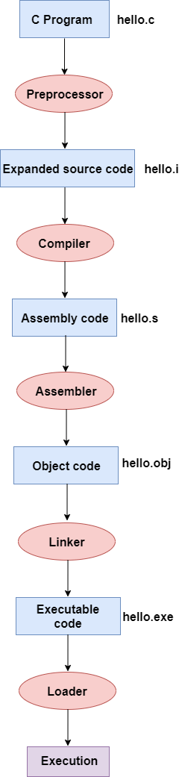
Steps to compilation
Pre-processing
This is the first phase through which source code is passed. This phase include:
Removal of Comments
Expansion of Macros
Expansion of the included files.
Conditional compilation
Compiler
The code which is expanded by the preprocessor is passed to the compiler. The compiler converts this code into assembly code.
Assembler
The assembly code is converted into object code by using an assembler.
Linker
The job of the linker is to link the object code of our program with the object code of the library files and other files. The output of the linker is the executable file.
The loader will then load the executable file for the execution.

